Slide 1
Configurators for Solid Edge
Madison Miner, Software Engineer, EDA, Inc.

Slide 2


Presenter background
EDA, Inc. (Engineering Design Automation, Inc.
EDA has been an automation consultant for over 23 years.
Madison has been a software engineer @ EDA for 11 years.
EDA has experience automating Solid Edge, SolidWorks, AutoCAD, Google SketchUp, MS Office and developing custom applications.
EDA has automated product configuration, quoting, drafting, design, engineering for numerous manufacturers.
EDA is a Siemens PLM Solution Partner for Solid Edge.

Slide 3
Questions to be answered during this presentation
What is a configurator?
Who benefits from a configurator?
What qualities should you look for in a good configurator?
Sample applications built by EDA (web and non-web based)
Q & A

Slide 4
What is a configurator for Solid Edge?
Creates configured Solid Edge parts, assemblies, drawings from simple user input – many different levels of Solid Edge Automation possible
Configurators can be very simple – Basic: setting up parametric models in Solid Edge and controlling them via the Variables Table.
A more complex configurator application might include links from the Solid Edge Variables Table to an Excel spreadsheet that contains design calculations.
The most automated solution would include file management (making new copies, renaming, relinking files), might include a web-interface for customers or outside sales, and would create not only Solid Edge models & drawings, but also manufacturing files like DXF, DWG, or SAT files.

Slide 5
What type of company needs a configurator?
Companies that design custom products: Their customers can select custom sizes, add and remove product options
Companies in competitive marketplaces: A configurator can significantly reduce the turnaround time from sales to manufacturing by restricting product configuration choices, generating custom parts & drawings without human intervention, and allowing flat pattern or other files to go straight to manufacturing.
Companies whose products have design rules: In order to use a configurator, the product must be able to be automated using design rules.
For example: Conveyors, enclosures, steel structures, pressure vessels, elevators, office furniture.

Slide 6
Qualities of good configurator software
Utilizes widely available software to store design info: Most companies already use MS Excel to store design calculations and product options. Beware of configurator software that requires you to store design info in formats that can’t be accessed or maintained by your own engineers.
Creates multiple types of output files: Configured 3D models are just the first step. 2D proposal & approval drawings, manufacturing detail drawings, flat patterns, and PDF files are also crucial for most companies. Make sure the configurator you are considering can output all the specific types of files your company will need.
Has a Web-based interface/option: Web based applications allow the company to open the configurator up to outside sales, or to customers. Also can simplify program updates. Makes configurator available 24-7, worldwide.
Notes:
f

Slide 7
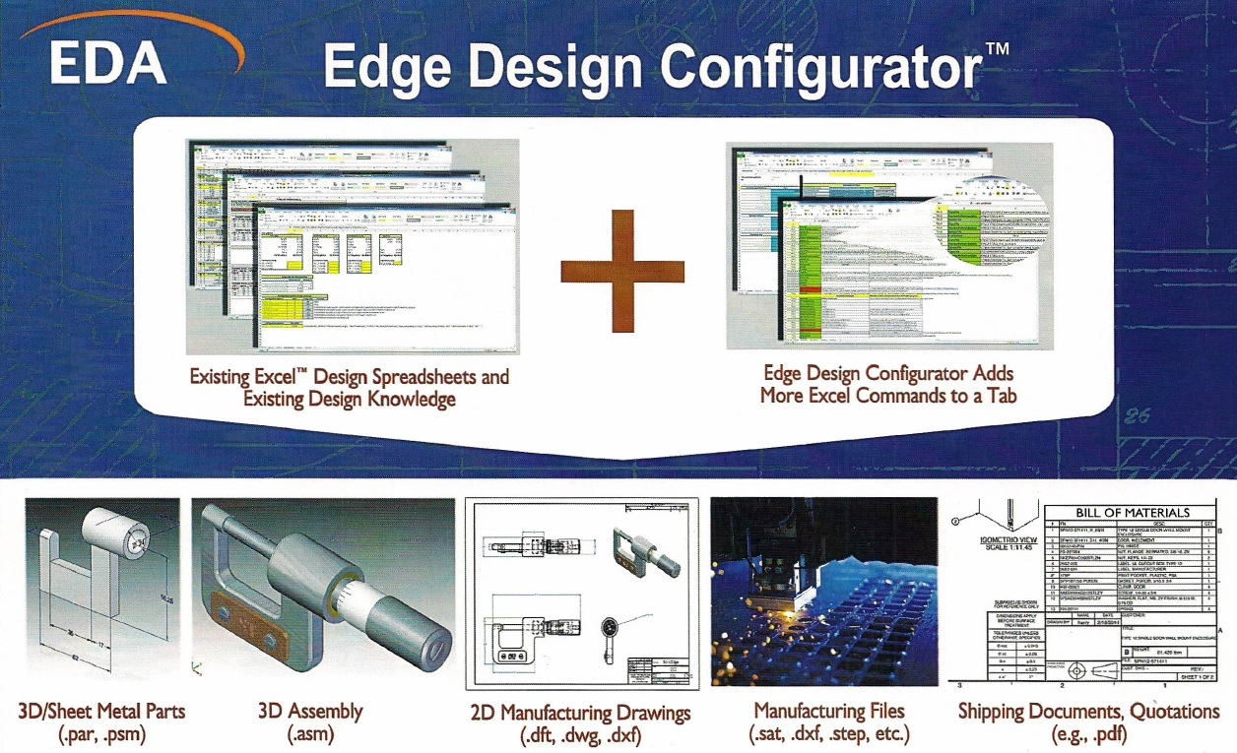
EDA Edge Design Configurator

Slide 8
EDA Configurator examples
Solid Edge Automation Applications Developed by EDA, Inc.
A Web-based solution: custom shims ordered online, Solid Edge models, drawings & flat pattern files generated automatically with shipping documents by the configurator.
Non-web based solution: custom electrical enclosures configured by engineers in MS Excel, then a single click creates new Solid Edge models, assemblies, assembly and part drawings, flat patterns, DXF & SAT files for manufacturing, and PDF files.
EDA’s Edge Design configurator can be used for either type of solution, works with existing Solid Edge models & existing Excel design spreadsheets.

Slide 9
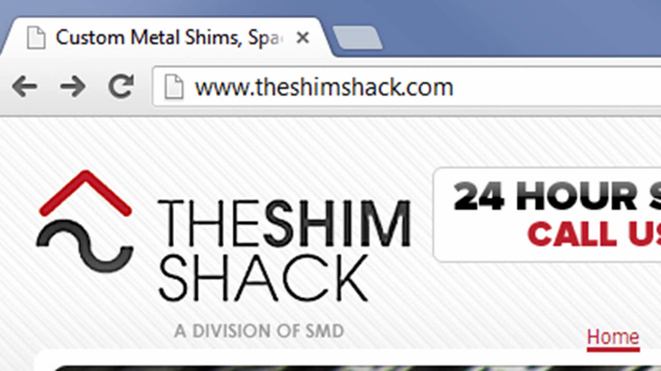
Web-based Solution

Slide 10
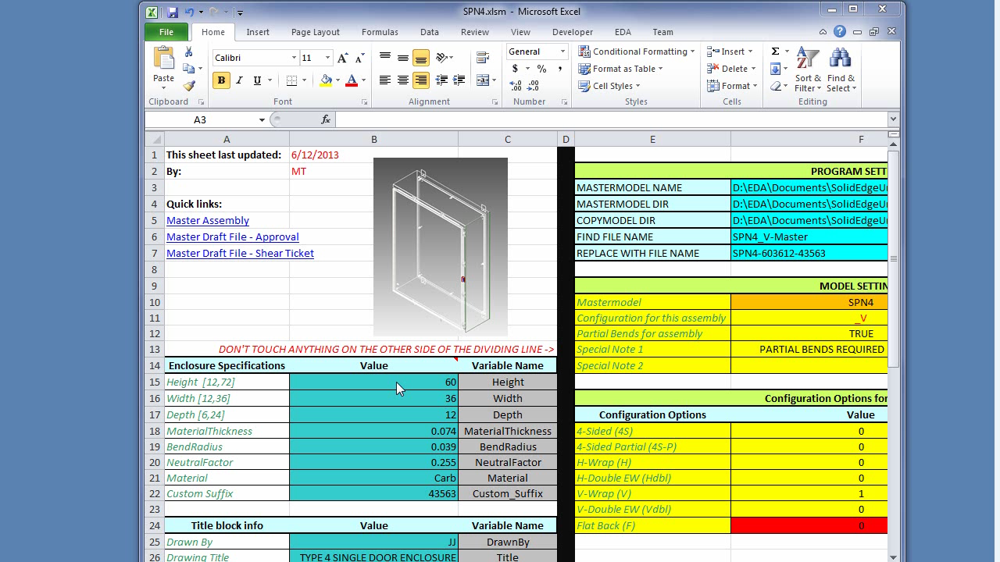
Edge Design Configurator

Slide 11

Thank you! Questions?
Madison Miner Software Engineer Engineering Design Automation, Inc.
5747 Hannegan Rd. Bellingham, WA 98226
Phone: (360) 398-1319 Website: www.edainc.net
E-mail: madison@edainc.net

